Slide 1
Digital Angel
Workshops

Slide 2
Guidelines to design/analyze features
Define a legend
  Representing a Database
  Representing a role/user
  Representing reports
  Representing telemetry data
  Representing relationships
  Describing the lines
Every feature must have inputs, process, output and role
Every feature must be simple and capture the minimum scope for the feature

Slide 3
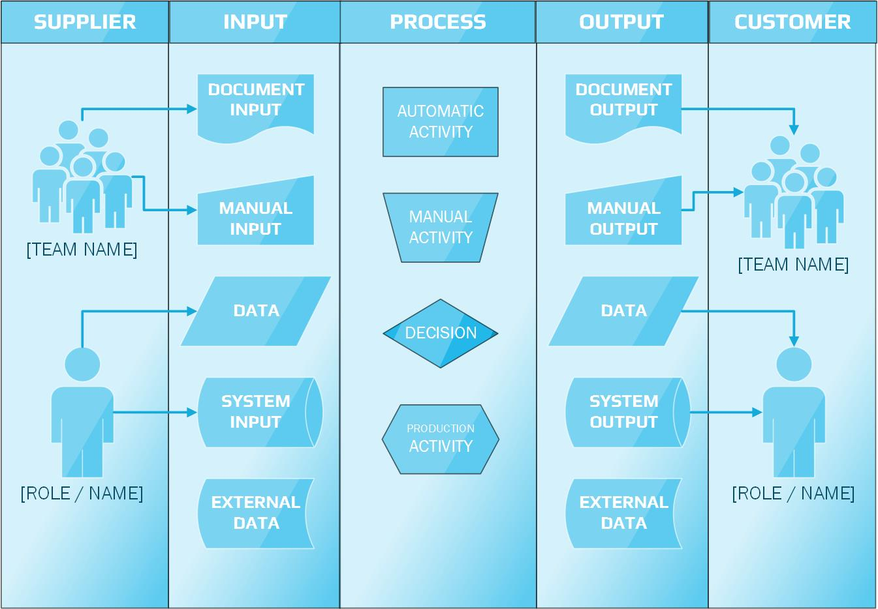

Slide 4
Scope of Minimum Viable Product (MVP)
Inputs provided by Deak
1. Ability to upload/track/enter mattress and sensor information
2. Ability to assign mattress to an entity (room/patient)
3. Ability to track patients
4. Creation of a Nurse/Caregiver community to view patient activity
5. Integration/canvas with smart mattress with visual of weight movement
6. Ability to create reports based off real time data
7. Ability to create/modify alerts based off real time data
8. Ability to manage Org users/licenses
9. Ability to assign patients to a Nurse/Caregiver
10. Must have ability to be HIPPA compliant (discuss further)
11. Architecture must allow for multiple locations for one customer
12. Must have multiple and modifiable role-based structure
13. Should be mobile ready
14. Must have ability to track patient/caregiver interaction

Slide 5



Feature: Ability to upload/track/enter mattress and sensor information
Supplier
Input
Process
Output
Customer
Script
UI
SQL
Get Mattress,
sensor other formats data
Device Metadata
CSV/Excel/JSON
Get Data
Upload Mattress and Sensor information
Device DB
Update
Access
Enter Mattress and Sensor information
Device Metadata
(Manual Entry)
Get Data
Get Mattress,
Sensor data
Patient DB
Track the mattress and sensor
Device DB
Access
Device DB
Update
Get Patient,
Device, Room IDs
Get track data
Room
DB
Tracking Report
Reports

Slide 6



Feature: Ability to assign mattress to an entity (room/patient)
Supplier
Input
Process
Output
Customer
Script
UI
SQL
Get Mattress-Id & Patient-ID
Assign mattress to a Patient
Patient DB
Get Mattress-ID & ROOM NO
Assign mattress to a Room
Patient –Mattress Assigned DB
Access
Device DB
update
Update
Patient information
Get Patient Data
Room
DB
Alerts
Alerts & Actions
Reports
Update
Room Information
Get Room NO

Slide 7


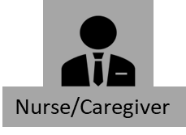
Feature: Ability to track patient
Supplier
Input
Process
Output
Customer
Script
UI
SQL
Healthcare DB
Get Mattress_ID, Caregiver_ID, Patient_log,
Medical images, Lab Reports, Blood_Test_Reports
Track Patient movement
Reports
Patient
DB
Patient, Name, Age, Address, DOB, SSN, Blood Type, city, state
Alerts & Actions
Changes in Vital Signs
Messages

Slide 8



Feature: Creation of a Nurse/Caregiver community to view patient activity
Supplier
Input
Process
Output
Customer
Script
Caregiver
DB
UI
SQL
Nurse/Caregiver information
Get Nurse/Caregiver Data
Healthcare DB
Patient Activity Report
Access
Patient information
Get Patient-ID
Patient DB
Reports

Slide 9


Feature: Integration/Canvas with Smart Mattress visual of Weight movement
Supplier
Input
Process
Output
Customer
Script
UI
SQL
Patient DB
Weight Movement Visualization
Get Patient , Sensor & mattress data
Access
Sensor DB
Heat Map Images
Reports
Threshold Values, Alerts, Actions
Mattress DB
Alerts
Alerts & Actions

Slide 10
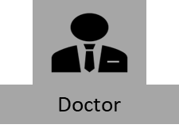

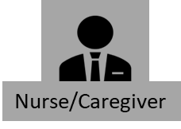
Feature: Ability to create reports based off real time data
Supplier
Input
Process
Output
Customer
Script
Patient Information
UI
SQL
Patient_ID,
Name,Sensor1,sensor2,
sensor3
Sensor Telemetry Data
Analytics
Dashboards,Reports
Reports
Patient DB
Sensor DB

Slide 11


Feature: Ability to create/modify alerts based off real time data
Supplier
Input
Process
Output
Customer
Set of Rules/Instructions
Get rules
Script
Create
Modified Patient DB
UI
SQL
Update
Sensor Device Real-time Data
Access
Get Sensor real time data
Triggers
Send alerts to Caregiver
Alerts
Mattress DB
Alert Log
Patient DB
Get Mattress, Patient, Sensor Information
By Mobile device
Access
Sensor DB

Slide 12



Feature: Ability to manage org users/licenses
Supplier
Input
Process
Output
Customer
Script
UI
SQL
Permissions Enable or Disable
Grant or restrict permissions
Admin DB
Licensing
Modified Admin DB
Access
Update
Subscription
Manage User’s
And Access
Permissions Enable or Disable

Slide 13



Feature: Ability to assign patients to a Nurse/Caregiver
Supplier
Input
Process
Output
Customer
Caregiver
DB
Rules
Patient DB
Get patient,
caregiver
Room ID
Patient-Caregiver Assignment
DB
Access
Assign Nurse to a Patient
Update
Access
Room DB
Assign Caregiver to a Patient

Slide 14


Feature: Architecture must allow for multiple locations for one customer
Supplier
Input
Process
Output
Customer
Patient_ID, Name,Age,Mediical_reports,Lab_reports
Patient Information
ORG
Designing Architecture
Block-A
Room
Patient DB

Slide 15



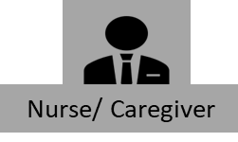
Feature: Must have multiple and modifiable role-based structure
Supplier
Input
Process
Output
Customer
Admin DB
Modified Admin DB
Modify/alter
Nurse/Caregiver Roles
Get Nurse/
Caregiver Information
Access
Update
Caregiver DB
Modified Nurse/Caregiver DB
Modify/alter
System Roles
Reports

Slide 16



Feature: : Should be mobile ready
Supplier
Input
Process
Output
Customer
Access
App Information
App Access
Mobile Access Ready
Access
Connectivity

Slide 17


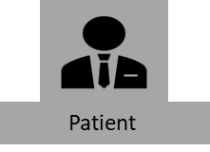
Feature: : Must have ability to track patient/Caregiver interaction
Supplier
Input
Process
Output
Customer
Track
patient data
Patient Information
Chatter
Tracking
Access
Update
Access
Alert/Text History
Nurse/Caregiver Information
Track
nurse/caregiver data

Slide 18
Ability to be HIPPA compliant

Slide 19
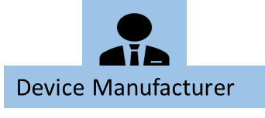



Digital Angel - User Roles
Term Definition | Description
 | Device Manufacturer Responsible for providing the metadata of the device
 | Digital Angel Administrator Responsible for managing the Digital Angel administration tasks
 | Doctors Responsible for examine patients, review their medical history, diagnose illnesses or injuries, administer treatment and counsel patients on their health and well being
 | Nurse/Caregiver Record medical history and symptoms Collaborate with team to plan for patient care Monitor patient health and record signs. Administer medications and treatments. Perform diagnostic tests. Educate patients about management of illnesses

Slide 20


Digital Angel - User Roles
Term Definition | Description
 | Digital Angel Users Responsible for using the app
 | Community Community health nurses is to provide treatment to patients and community health nurses offer education to community members about maintaining their health

Slide 21
Digital Angel – Databases (DB)
Term Definition | Description
 | Patient Database Patient Metadata (e.g., Name, Id, Phone, Age, Gender, Weight, Blood Group…) Patient Vital Readings (e.g., HeartRate, BP….)
 | Device Database Name, Id, Manufacturer
 | Caregiver Database Name, Designation, Id, Alloted Room, Alloted Patient
 | Room Database Room Number, Mattress Information, Location
Patient DB
Device DB
Caregiver
DB
Room
DB

Slide 22
Digital Angel – Databases (DB)
Term Definition | Description
 | Mattress Database Id, Mattress Name, Manufacturer Name, Healthcare Center, Date of Manufacture
 | Patient-Mattress Assigned Database Mattress assigned to a patient is stored in this database, Mattress ID is linked up to Patient ID
 | Sensor Database Serial Number, Status, Readings, Units
 | Admin Database UserNames, Passwords, Organizations, Licenses, Subscriptions, Pricelists, Products, Services, Sensors, Sensor Location
Mattress DB
Patient –Mattress Assigned DB
Sensor DB
Admin
DB

Slide 23
Digital Angel – Databases (DB)
Term Definition | Description
 | Modified Admin Database Records modified and saved in the admin database
 | Modified Patient Database Records modified and saved in the Patient database
 | Upload Patient Database Records inserted in the Patient Database
 | Healthcare Database Healthcare Metadata (e.g., Healthcare Name, Address, Email, Phone, Services…) Staff Data (e.g., Doctors, Nurses, Caregivers, Admin and Accounting) Patient Database Device Database (Mattress, Sensor Information)
Modified Admin DB
Modified Patient DB
Upload
Patient DB
Healthcare DB

Slide 24
Appendix

